Slide 1
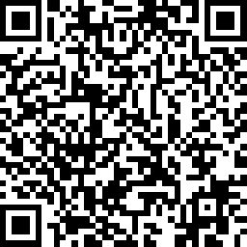
Breakfast & Pre-Survey
Grab some breakfast and find your seats according to your sticker
Take our Pre-Survey before we begin session work
https://www.surveymonkey.com/r/FCSpretest
We will kick off at 8:30am
Pre-Test
Notes:
Have open while Britt and Sierra run registration (Specify at registration that they need to sit at “sticker table”)Make reminder announcement
Jodee to be in room with students mingling

Slide 2


UNITED STATES FALL COLLABORATION SUMMIT

Slide 3
WELCOME
Sierra Peterson
Regional Program Manager, Enactus United States
Britt Livingston
Regional Program Manager, Enactus United States
Jodee Ledford
Career Connections Manager, Enactus United States
Notes:
Britt- round robin introduce us
We are so excited to welcome students, faculty, and business representatives to our Fall Collaboration Summit here at BIC Then introduce Kristie Raines VP of People & Culture

Slide 4

BIC SUPPORT STAFF
Katie Murnane
Scott Goldstein
Adriana Pascarella
Tim Folley (Caf)
Brian Goldsmith (Facilities)
Zoila
Notes:
Britt-We are so excited to be back at BIC this fall, and before I hand the mic to Kristie for opening remarks I wanted to give a big thank you to Bic and all of their incredible staff for helping us plan today. I wanted to introduce some of the people here today that will be helping. If you have any questions and you cannot find us these are also wonderful resources.

Slide 5

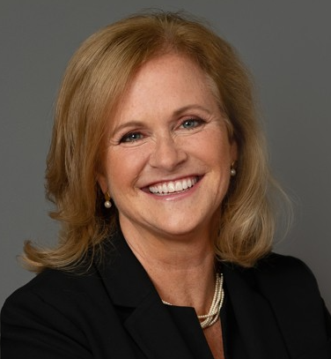
Welcome from
Kristie Raines
VP of People & Culture
https://www.youtube.com/watch?v=ePrI9oYTA8E&ab_channel=BICGroupOfficial
Notes:
Britt-Ask to introduce herself and what she does

Slide 6
Enactus US Opportunities
Virtual Enactus Entrepreneurial Exchange- Nov. 28 – Dec. 16
This 3-week program will be an entrepreneurial immersion that will take students through project ideation, implementation, and impact phases. Students will focus on one of the United Nations Sustainable Development Goals and join others that are passionate about the same goal. They will collaborate and engage with Enactus Morocco students and together drive a team project pitch to create impact. It begins late-November and runs into early December.
Important Information
Register by Friday, Nov. 25, 2022
Mandatory kick-off meeting - Monday, November 28, 2022
Prize Money
1st Place Winner: $1,250
2nd Place Winner: $750
3rd Place Winner: $500
enactusunitedstates.org/Enactus_Entrepreneurial_Exchange
Notes:
Sierra

Slide 7
Enactus US Opportunities
BNY Fellows Program
The BNY Mellon Enactus Student Fellows Program is designed to help top Enactus students strengthen their capacity to create and deploy higher quality projects that have sustainable impact and to better prepare students for successful careers.
The 2022-2023 program is focused on four competency areas:
Entrepreneurship
Leadership
Career readiness
Project management
Program Eligibility Requirements:
Be a current student on a Enactus United States Team registered on Enactus +
Commitment to complete the entire program by April 1st, 2023
training.enactus.org/bny-mellon-fellows
Notes:
Sierra- Introduce and Discuss
Highlight: It's a self paced course this year with $75 going to the team and $75 Amazon gift card going to the individual for completion. Last Year

Slide 8

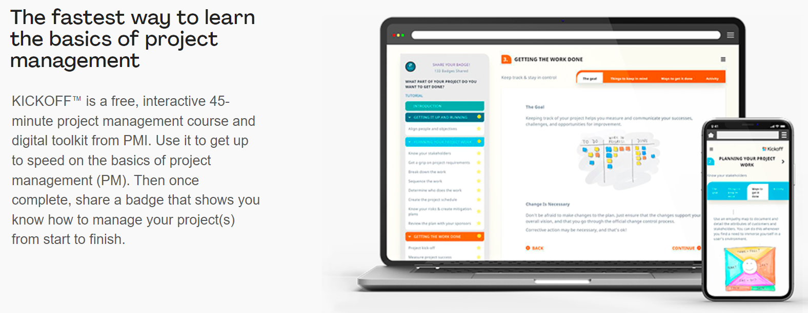
Enactus US Opportunities
Project Management Institute (PMI)
Notes:
Sierra-PMI has partnered with us to be involved in our BNY Program, but they have also asked us to share this opportunity for you all.
KICKOFF is a free 45 minute Project Management course available to you now! We will be sending the link in our email later today.

Slide 9
Enactus US Opportunities
Standard Charter Foundation – Futuremakers Program
The Futuremakers Program will teach teams to develop disadvantaged groups in employability, career readiness, and entrepreneurship. Each college/university that joins receives funding support to assist them with starting an Enactus team and will be provided additional funding through Enactus corporate partners.
The Enactus/Futuremakers Program by Standard Charter aims to:
Tackle inequality and increase economic inclusion for young people across its markets.
Work with disadvantaged groups to gain new skills and expertise to improve their chances of getting a job or starting their own business.
Develop entrepreneurial skills and create jobs in order to realize positive impact on individuals and communities.
Kickoff and Information Session November 30, 2022 2pm CST
If you are interested in learning more or joining this imitative with Enactus, please have your advisor or team lead reach out to training@enactus.org
enactusunitedstates.org/futuremakers_program
Notes:
Britt-$500 seed money

Slide 10

Enactus US Opportunities
1 Race 4 Oceans – US edition
Win up to $10,000 to scale your project!
Project Focus Areas
Sustainable Marine Aquaculture
Sustainable Marine Fisheries
Coastal & Marine Habitats
Ocean Climate Resiliency
Direct Ocean Pollution
Deadline to Submit Action Entry Form: End of January
On Enactus + look up 1R4O
Notes:
Britt- interest form
Near or Farm from oceans
Exisiting projects, or projects that have been competed on can be repeated.
Be creative in project ideas

Slide 11
Project Design and Ideation
Notes:
Sierra- Next we are going to move into our Session work! Let’s discuss Project Design and Ideation
Please read out the

Slide 12

Notes:
You are not creating a project from just one of those goals- you can

Slide 13
Needs Assessment
What
A technique used to determine what steps need to be taken in order for a target to move from it's current state to its desired future state
Why
Understand factors at play
Lay the foundation for your projects long-term sustainability by addressing relevant needs towards your desired goal
Build buy-in early which increases long-term sustainability and community support
Notes:
Sierra-
How man of you have done a Needs Assessment
as many of you know one of the first things you should do when beginning a project is conduct a needs assessment.

Slide 14
Needs Assessment
Find your scope
Complete Assessment
Determine purpose and objectives
Define location and audience
Chose a core issue
Identify gap between reality and vision, and what steps you’ll need to take to bridge that gap
Network with current contacts to locate key stakeholders
Engage key stakeholders
Notes:
Sierra- Next, you find your scope, (Read slides)

Slide 15
Needs Assessment Strategies
Understanding pain point – What is the problem?
Interviews
Use open-ended questions. Avoid yes or no answers
Ask “Why?”
Look for patterns and themes
Additional research
Understand the context of the problem
Notes:
Britt- HOW MANY OF YALL HAVE DONE NEEDS ASSESSMENTS?
START HANDOUT- 5 MIN
What questions would you ask these individuals?
What outside research needs to be done?
Where would you get the information?
What patterns and themes would you look for?
Where are you seeing your interviewees struggling the most, using the question behind the question to find the root of the problem
Dandelion example

Slide 16
Problem Statements
Define the stakeholder/beneficiaries
What is the current reality vs. desired outcome?
What is the root cause?
Example:
I am a : _______(narrow description of stakeholder)_____
I am trying to: __ (desired outcome)___________________
But: __________(Barrier)____________________________
Because: _____(Root cause)________________________
Notes:
Britt -Activity: Students use the case study to come up with a problem statement in their groups
(Sticker team Session 1 stay with case study team, until end where they connect back to full team )
REMINDER_ YOU ARE NOT COMING UP WITH THE SOLUTION

Slide 17
Desired Impact
15mins
What would be your beneficiaries "perfect world"
Use problem statement as a guide
Write down as many solutions or ideal states you can think of
Think as big or as little as possible
What would be the biggest benefits if those solutions were implemented?
Notes:
Britt – think ideal state from D4D and potential metrics for impact (what will students want to focus on measuring to know they’ve accomplished their goal? How will they do that?). Come up with some directed questions to guide their breakout session.
5 min

Slide 18
Proposed Empathetic Solution
Important Problem
Does not solve the problem
Solves the
Problem Well
Not an Important Problem
Notes:
Britt-Using the sticky notes, identify how each proposed solution addresses the problem. Think about whether the solution is addressing the correct problem, or if it solves something else entirely. Is your solution feasible? Will it bring about the desired impact?
10 min

Slide 19
Connecting to Your Enactus Project
How can you use these strategies to develop strong Enactus projects at your school?
What problems will you address?
What is your desired impact?
How does your solution address the problem?
Notes:
Britt

Slide 20
BREAK
Notes:
Sierra Annoucement 10 minute Break

Slide 21

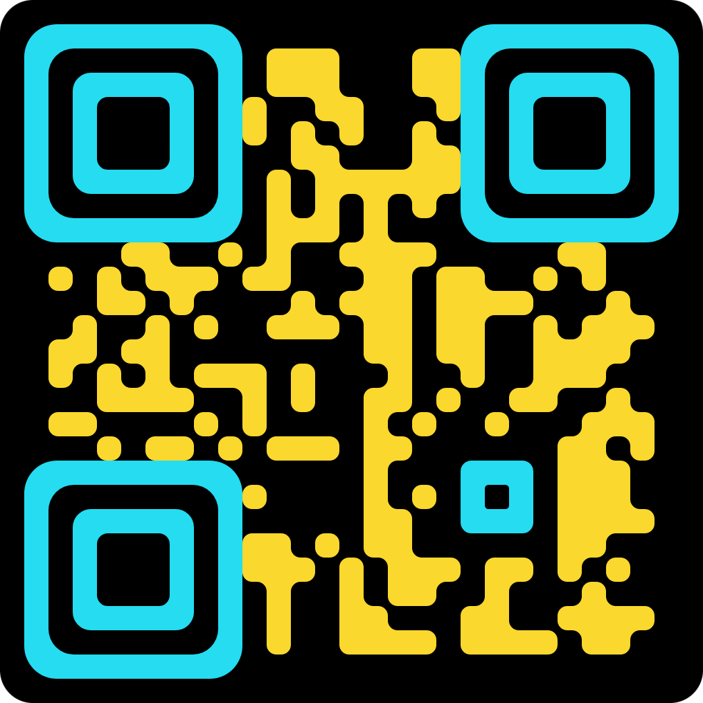
Enactus Career Advantage Program
Need a Job? Want an Internship? Get Connected.
Scan to Join the Enactus Career Advantage Program.
Notes:
Jodee

Slide 22
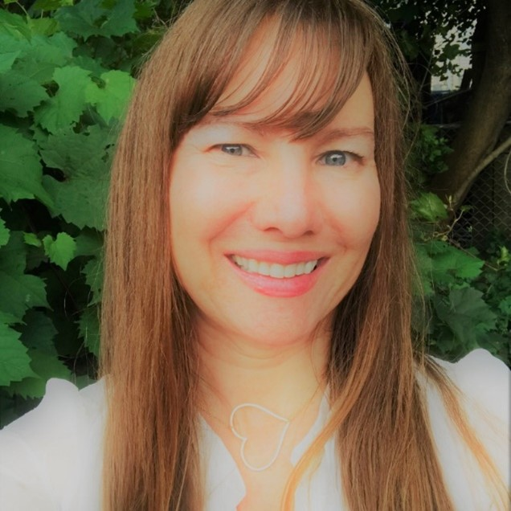
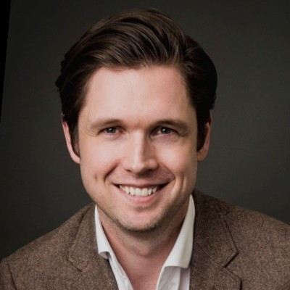
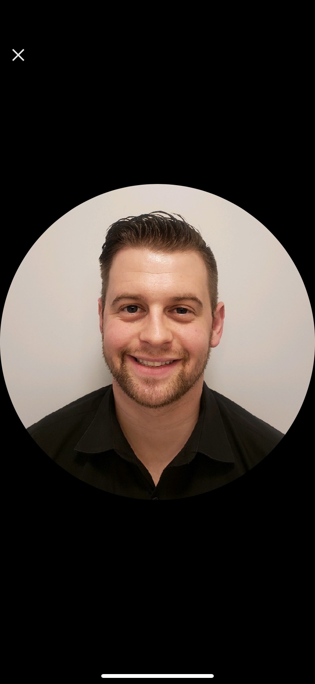
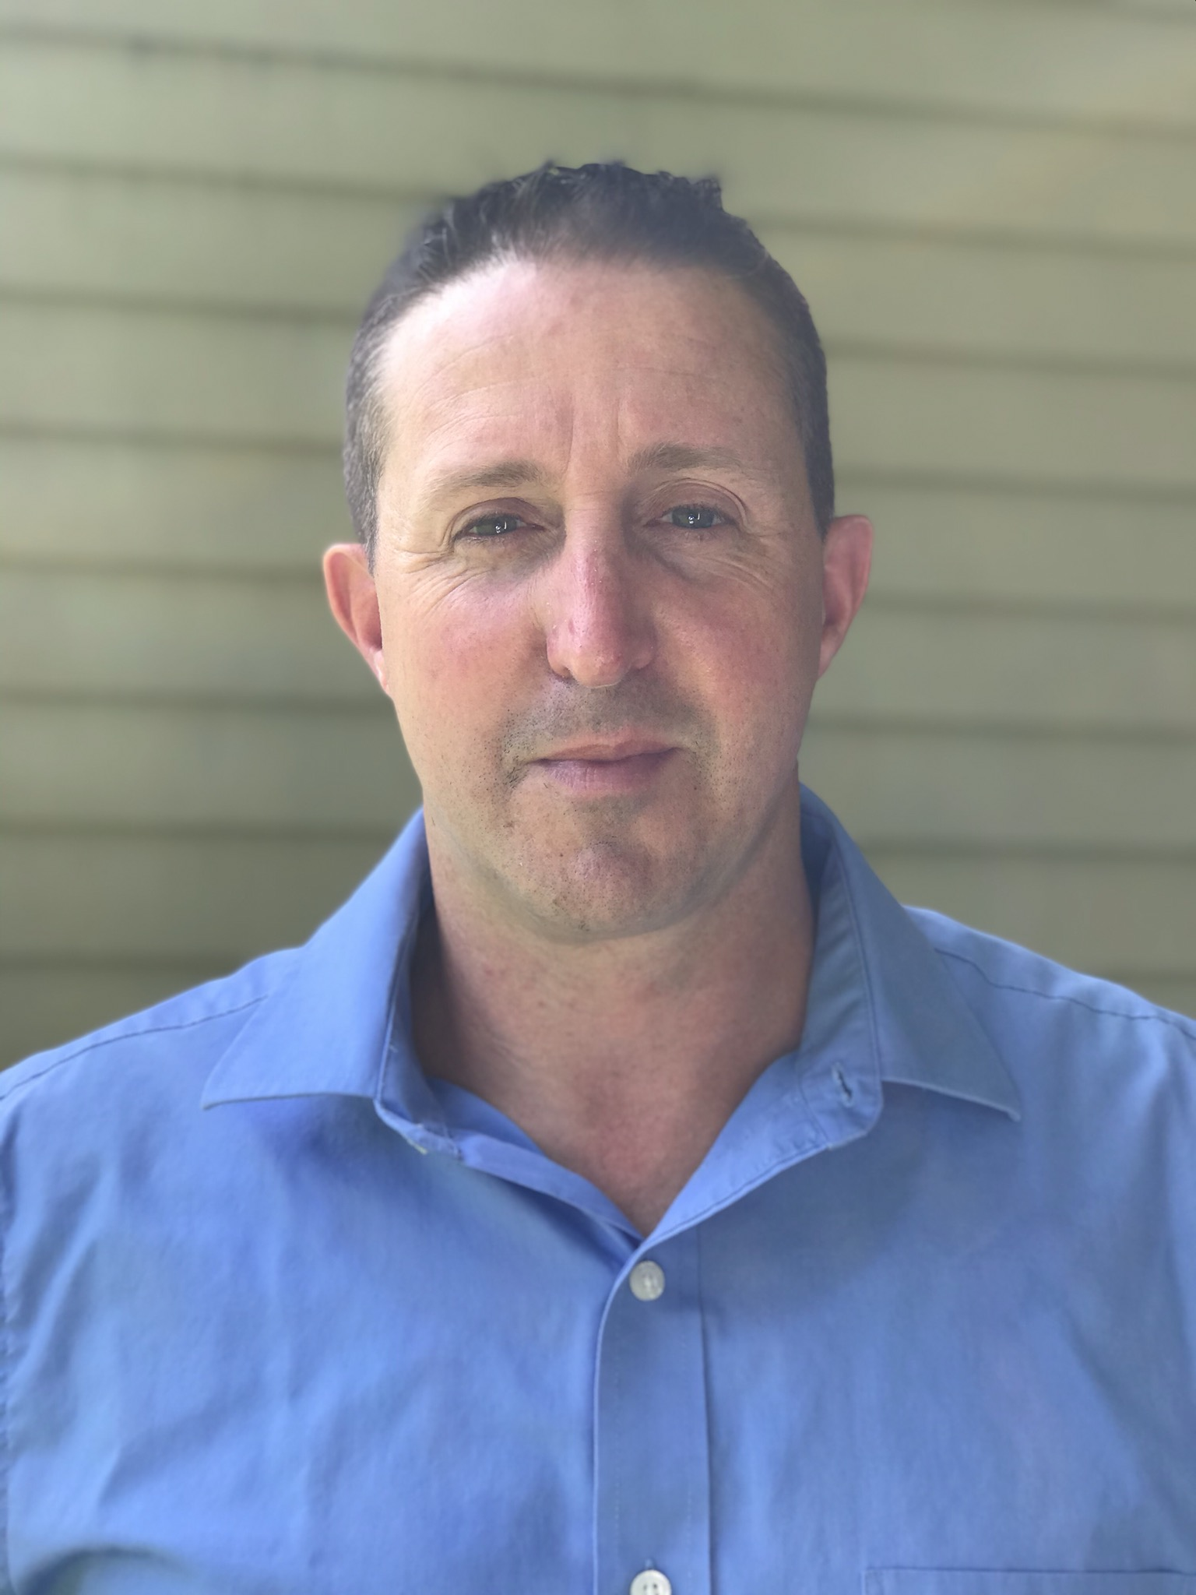
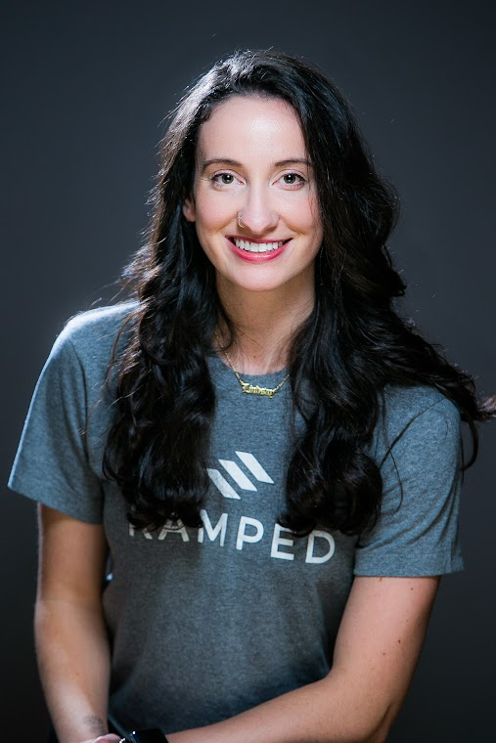
Career Panel
Jodee Ledford
Career Connections Manager
Enactus United States
Damien Cotter
Sr. Manager of Talent
BIC
Kyle Bohringer
Area Manager
Enterprise Holdings
Michael Lancaster
District Manager
Walgreens
Lyndsay Washbond
Career Coach
Ramped
Notes:
Jodee

Slide 23



NETWORKING LUNCH
Notes:
Jodee
Draw student for gift card
Dietary Conditions (lunches will be labeled) do not grab one labeled if you did not previously specify

Slide 24
Enactus Team Implementation
Notes:
Britt
Specify they need to sit with their Enactus team

Slide 25
PROJECT CATEGORIES – CHARITABLE PROJECT
Charitable Project
Meets felt need through relief
Does not meet the Enactus Criterion
Food & clothing drives, fundraiser for a third party, or volunteering for a local organization
Notes:
Britt- Bandaid Project

Slide 26
PROJECT CATEGORIES – STRATEGIC INIATITIVE
Strategic Initiatives
May not meet Enactus criterion
Serve ulterior relevant purpose
Fundraising
Engagement (campus networking events, guest speakers)
Notes:
Britt can be a good networking, community/campus awarness/engagement

Slide 27
Project Categories – Community Program
Strong program
Tackles social problem
Empowering solution, long-lasting change
Education-based activities such as workshops and seminars
Futuremakers is a great example!
Notes:
Sierra -Early Stage Project
A financial education program
· An entrepreneurial boot camp
· A consulting program for existing entrepreneurs
· Job skills workshops
· Mentorship
This is similar to a social enterprise, but the key difference is that it does not operate as a business, but rather as a program. The project addresses a need through education-based activities such as workshops and seminars.
Want to take your project to the next level?
Monetize your services
Train and employ your audience
After conducting a secondary needs assessment, reassess to identify contributing factors
Integrate empowerment opportunities

Slide 28
Project Categories – Social Enterprise
Strongest project
Business that tackles a social problem
Empowering solution
Long-lasting change
Highest level of life-changing impact
Notes:
Sierra
World Cup Qualifier Project
This is different than a community program because this program is acting a sustainable business rather than a workshop or program
Monetize your services
Train and employ your audience
After conducting a secondary needs assessment, reassess to identify contributing factors
Integrate empowerment opportunities

Slide 29
PROJECT CATEGORIES ACTIVITY
5mins
Work with your team to categorize the projects listed on the provided handout. Use the chart on the back for help.
Notes:
Sierra- Pass out Project Categories Handout
5mins with teams and a 3 minute review
Enactus Team

Slide 30
REVIEW YOUR PROJECTS
What category are your projects in currently? What could you do to improve them?
Notes:
Sierra– thinking of Enactus projects

Slide 31
ENACTUS TEAM SUSTAINABILITY SESSION
What is team sustainability?
What does this look like for your team?
Notes:
Britt
Ask teams what it means to them, and do giveaways for those that respond
Team Sustainability is setting up your team and projects to continue beyond your time on the team
What enactus has found that is essential for success

Slide 32
ONGOING RECRUITMENT AND PROMOTIONS
DEVELOPING A CULTURE OF RECRUITMENT AND PROMOTION
Creating a culture where all members see recruitment as a responsibility & something they can impact
Recruitment is seen as an ongoing process
How to keep spreading the word and promoting?
The Enactus team at UMKC calls it "shameless self-promotion"
Emphasize diverse student majors in recruitment strategy
Notes:
Britt Because your team is constantly losing members, its important that your team invests into ongoing year-round recruitment.
Each member can play an important role in recruitment. Each member has a unique network of friends and classmates that could become future members. Think if each member can recruit at least 1 friend each semester – your team would double in size! How can you encourage your members to create a personal goal around recruitment?
Some of the most effective recruiters are those who are willing to talk with new people each day. University of Missouri Kansas City has a concept they call Shameless Self Promotion, as they explain, “We have found that nobody knows what your team is doing unless you tell them, but once you tell them, they are interested and happy to help the team or pass on the word to their own connections. “

Slide 33
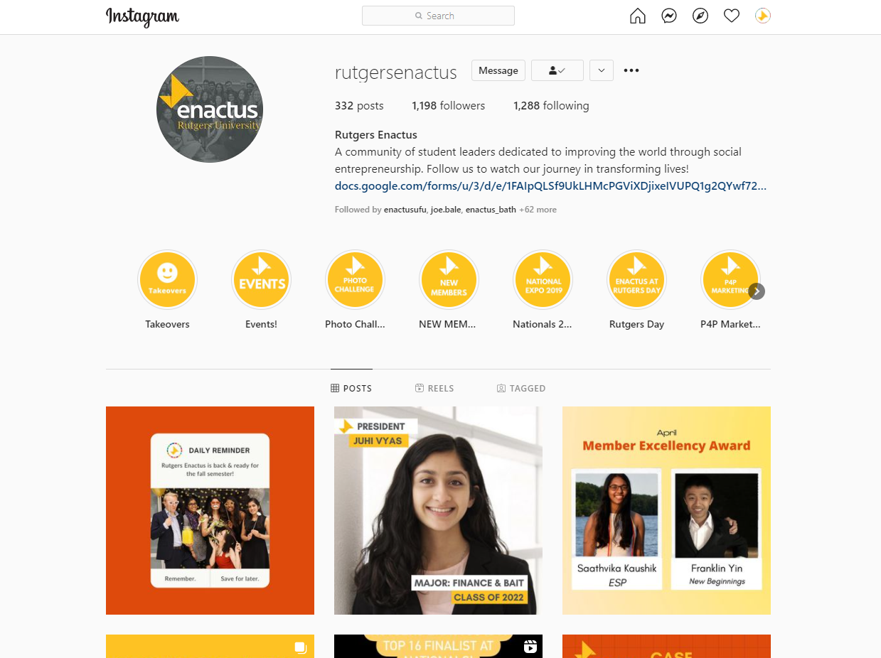
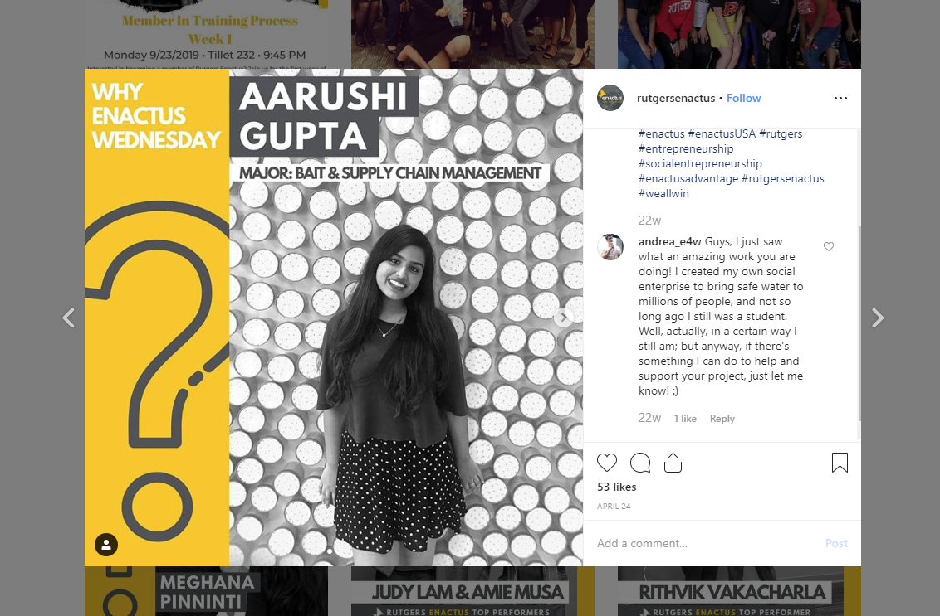
RUTGERS ENACTUS INSTAGRAM
Notes:
Britt- A while back, the Rutgers Enactus team did a series called “Why Enactus Wednesday” where they would spotlight members and ask them why they were part of Enactus. This is a great place to start when thinking about your recruitment strategies. After all, if you aren’t sure why you do it, how can you convince someone else to join the team?
Team leadership should be active and engaged on social media

Slide 34
ONGOING RECRUITMENT AND PROMOTIONS
Word-of-mouth
Elevator pitch – what’s your pitch?
Enthusiasm > information
Why statements
Build network of staff and faculty advisors
Attend events (student organization fairs)
Advertise – get your name out there
Notes:
Sierra-
So what are the key tactics?
(DONE with Enactus TEAM)
Word-of-mouth is important because it can happen any place and any time. Do your members feel comfortable with their elevator pitch? Practice with your team. Ask people to share what works best for them.
We’re going to go through an exercise to help each of you develop your own “Why Enactus” statement. Your Why statement is different from your Elevator pitch.
Give time For Activity
Another benefit to starting with WHY, is that it helps you connect with your enthusiasm. If you lead with enthusiasm you’ll be much more effective when recruiting students, faculty, business partners, and stakeholders. HOW you say something can be more important that WHAT you say.
One of the most effective ways to recruit new talent is through the staff and faculty of the school. Develop a relationship with teachers and advisors – explaining what Enactus is and how they can help you attract students. A few simple ways they can help are to allow you to pitch Enactus in their class, agree to hand out fliers / post meeting information, and to agree to recommend Enactus to their students who stand out.
Another way to recruit is to put yourself where students are. Attend events, have an informational table set up in the student center during lunch. Be visible.
Another great way to be visible is to have an Enactus team t-shirt. Coordinate days when all the members will wear your shirts so you can begin to create the feeling of a growing presence.
Finally, advertise and market through traditional channels. Develop your social media presence – highlight individual members and personalize their experience and the many benefits. Post fliers. Do whatever it is you think that will help attract the attention needed to make someone interested enough to attend a meeting.
What strategies work for your team?

Slide 35
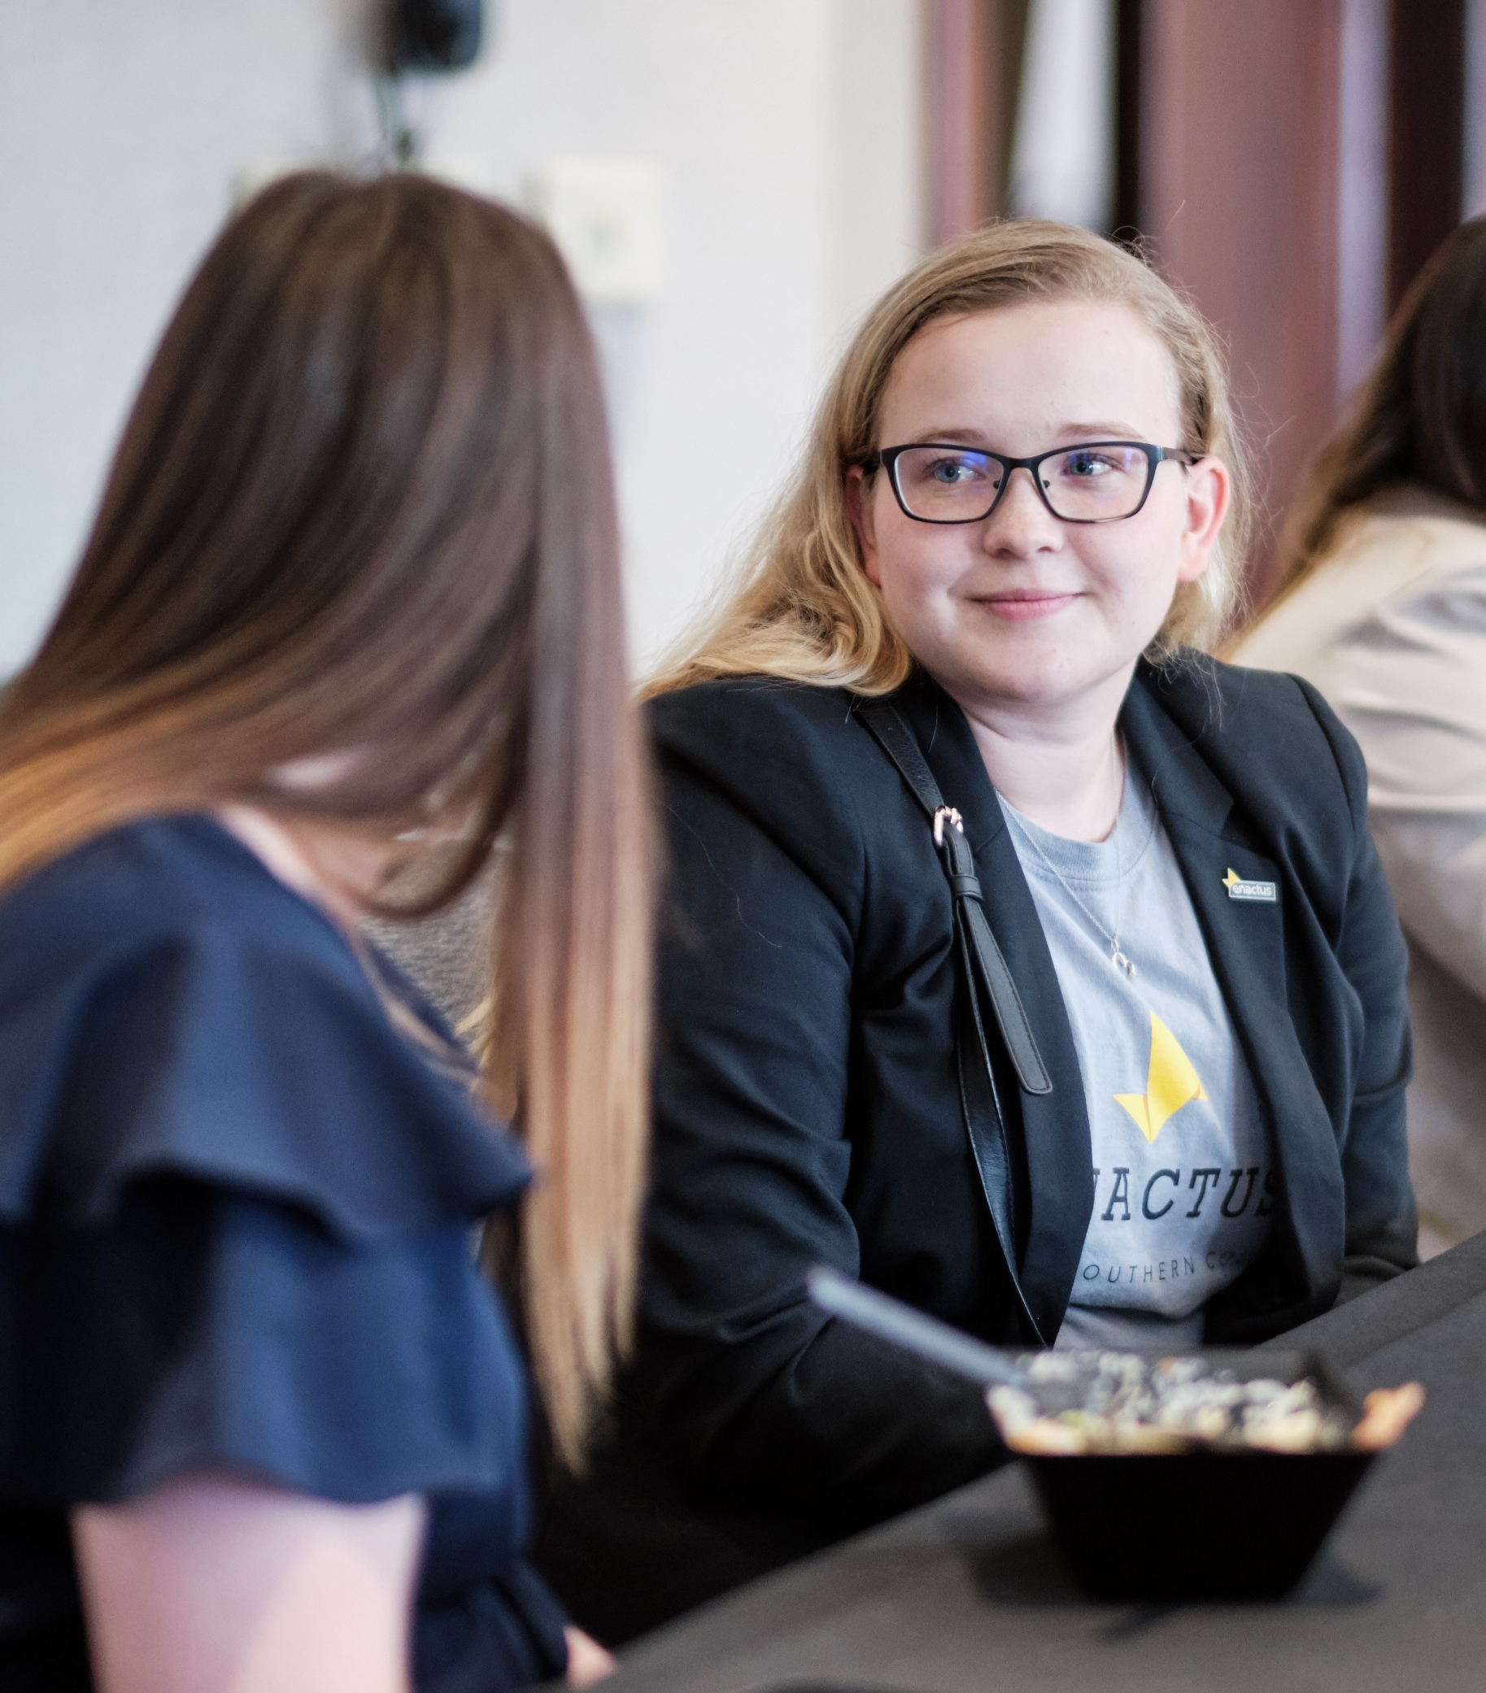
LEADERSHIP DEVELOPMENT & SUCCESSION
Develop a mentorship program
Executive and senior members to mentor 1-3 younger members.
Look at leadership positions and make sure succession is prepared
Train & support new members
Learn from new member perspective
Notes:
SIERRA Another great strategy is to build in a mentoring process. In the Fall semester take your leadership team and assign them to mentor 1 or 2 members who they think might replace them in the future. Have them start leading more in the Spring Semester. Create an outline of expectations regarding how often they should meet, what key questions to ask, and how often the leadership team will discuss and evaluate what they are learning from the mentoring process.
One of the best ways to develop future leaders is through their active involvement. Another effective way to develop leaders is by getting them involved within positions that align with their top strengths and passions.
They have to get off of the sidelines and onto the playing field so to speak.
You’ll want to empower these members with opportunities to lead meaningful projects.
You will be able to observe their performance as a leader and more effectively coach and mentor them along the way.
As a current leader, another great way to develop leadership is through an active conversation with members on your team. If your leaders aren’t speaking with the members enough you’re likely not learning enough about those members and how you can more effectively engage them. Be sure you’re not focusing too much internally on your leadership team at the expense of your regular team membership. Remember – one day soon those members will comprise the leadership team.

Slide 36
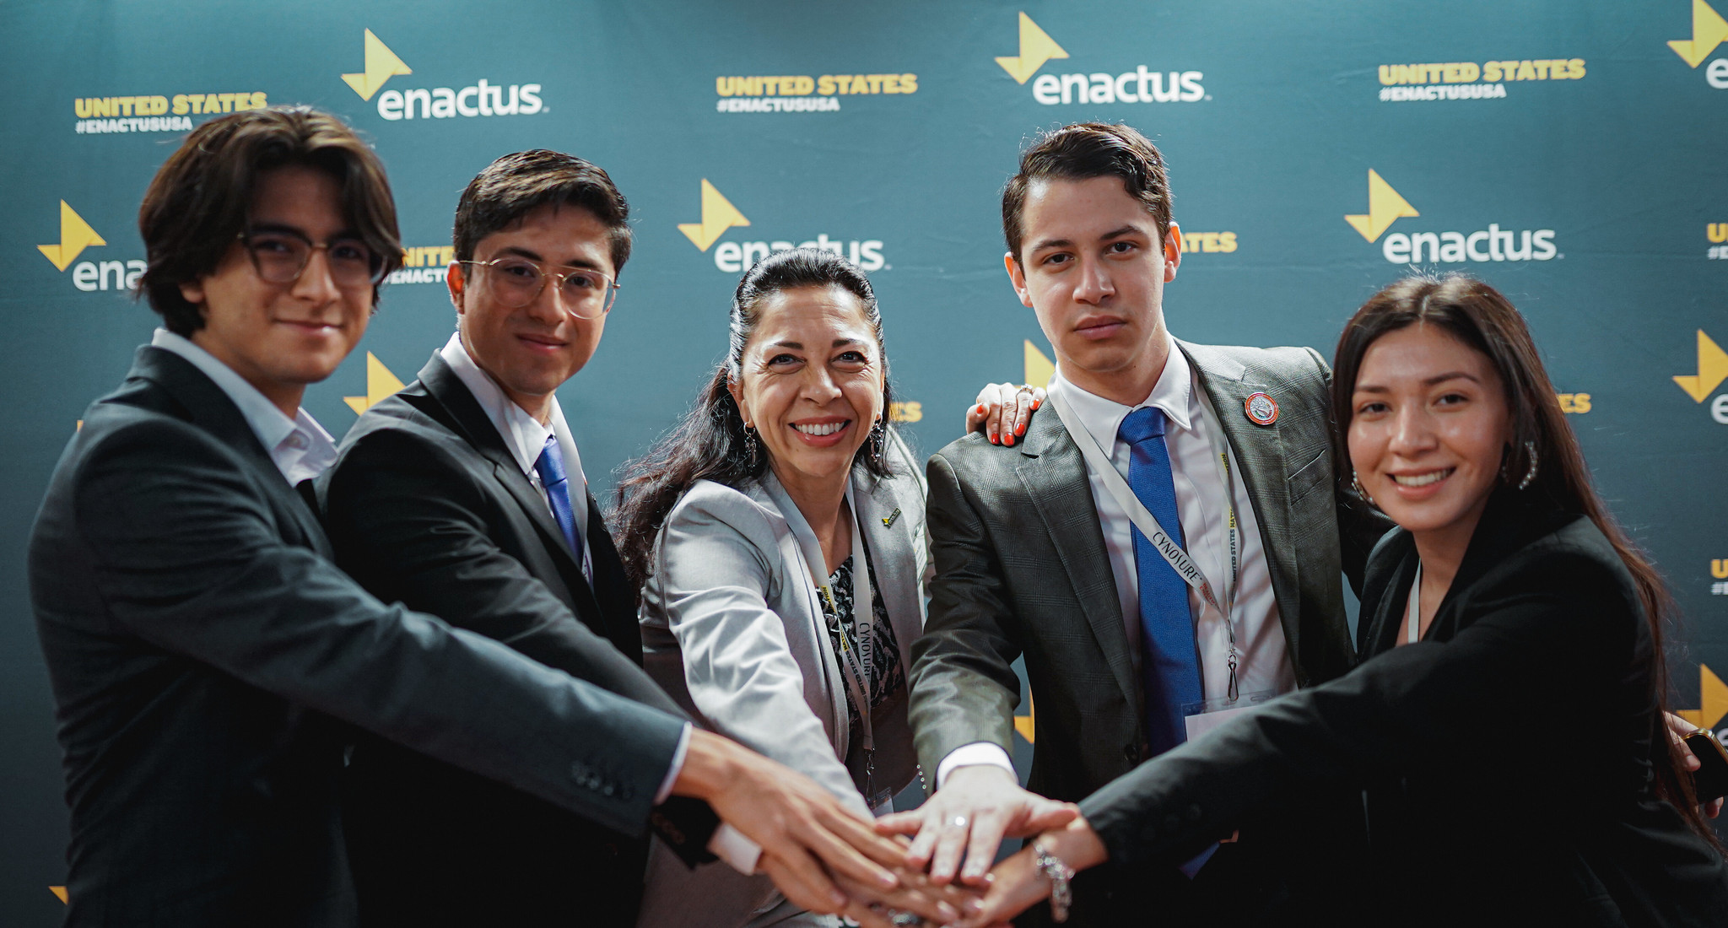
ADVISOR SUPPORT
Advisors are the most consistent point of leadership
Some advisors have led their Enactus team for upwards of 20+ years continuously
Think holistically about your advisor mix:
Teach and advise from freshmen to seniors
Teach and advise a wide variety of majors
Notes:
Britt Last but not least.
We cannot talk about team sustainability without addressing the important role of the primary advisor.
They are the most consistent form of leadership - some advisors have been with their teams for more than 20 years!
There are a few ways to diversify your advisor mix to success.
Do your advisors teach or advise a range of students from freshmen to seniors? Its important to have access into networks of freshmen and sophomore students. One of the best ways is through professors that teach freshmen or sophomores or through academic advisors.
Do you have advisors from across multiple departments? It’s helpful to have advisors from multiple departments because they can help recruit a more diverse team. You’ll also find more support from administration since your club represents a wider group of students.

Slide 37
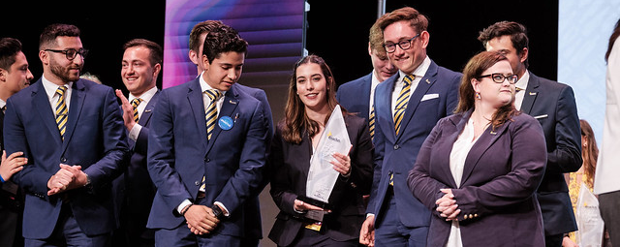
Securing Funding
Enactus competitions/opportunities
Business Advisory Board
Community resources
Grants
Investors
Partnerships
Notes:
Britt

Slide 38
7 POINTS OF TEAM SUCCESS
Maintaining clear team governance & set SMART goals
Encourage & facilitate new ideas
Time management
Delegation
Conduct your team & projects ethically
Utilize all forms of technology
Understanding Social Entrepreneurship
Notes:
SIERRA
Individuals need to know and understand the end goal and who to look to if they need more clarity/guidance specific, measurable, achievable, relevant and time bound
Create a culture where you empower all members of your team to share their unique perspectives and ideas
As a student you are busy- focus on making the most out of the time you have together to create the largest impact on your project.
Utilize all individual parts of your team and their unique strengths through delegation (Buy in comes when people are working on things they are passionate about)
If people know and respect your projects/business reputation, the more sustainable positive impact you can achieve People know who you are and what you represent show that
Modernizing your social media is pivotal to your networking, interaction, and growth. (Knowing back end analytics, understanding what makes each social media platform different and how it best serves you)
BRITT
7) SOCIAL E- Serves the environmental and social needs of a community while still being respectful of the culture you are adopting it into. Impact is more important than profit, but does not take away from the necessity of it.

Slide 39
Connecting to Your Team
Take some time with your team to answer these questions
Write down your answers are we go along
Notes:
SIERRA
Questions:
1) Set Smart goals for your project
2) Where are your creating space for everyone to share ideas and collaborate? If you notice a lack of buy in from indiviuals what can you do to break down that barrier?
3) Where has your team struggled ? In addition, make a short list of priorities that are most important to you and think about the long-term results of each if you dedicate X amount of time to them.
4) Delegation is imperative for anyone in a position responsible for those who oversee others. What are some problems you have seen whether it is your team or elsewhere in regard to this, and what are some ideas to collectively fix it?
5) What can you do with your own projects to ensure that your target is getting the best service from you, or where can you implement the service aspect in your own projects? (REVIEW)
6) Technology is a tool that anyone in the world can use to make massive leaps with their brand that would otherwise take years to do. What can you do as a team to increase you reach, engagement, awareness and impact of your projects through social media? (This could be marketing, expansion, connectivity, sales)
7) How does your project meet social or environmental needs in it’s area, and how do you ensure it is profitable?

Slide 40
BREAK
Notes:
10 min break Grab a snack use the restroom mingle with other teams

Slide 41
Competition Prep
Review Judging Criterion
Present Project Pitches
Project Q&A
Notes:
Britt
Based upon their Enactus Projects
90 seconds with 30 second q&a

Slide 42
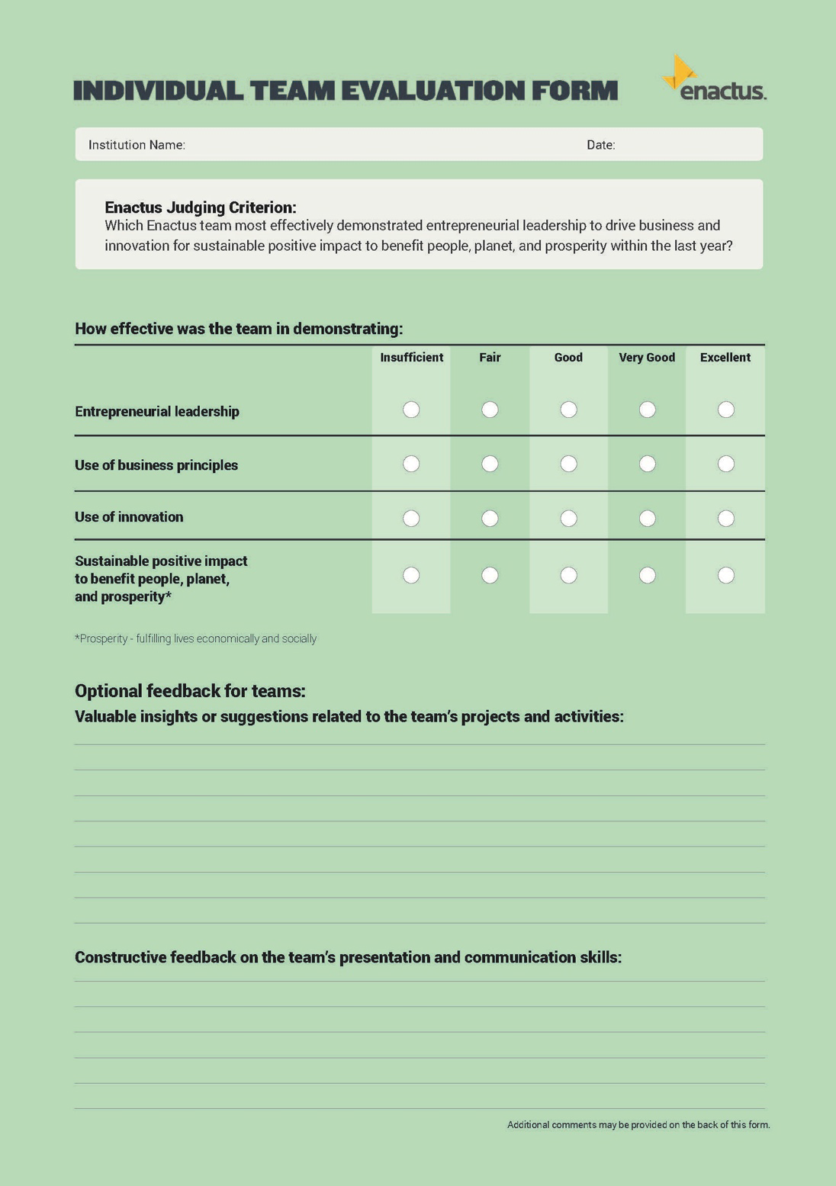
Notes:
Britt

Slide 43
Pitching Your Project
When networking and pitching your project, many people focus completely on themselves, but don’t forget to show the other person that your project can bring value to them as well.
What is the most vital and relevant information about my project?
What is the most important thing to know about my project?
What value can my project bring to you or your company?
How can our project connect to you and your company?
Notes:
Sierra- Read slide
Write these 4 questions down and be sure to answer them in your group

Slide 44
COMPETITION
Case Study Application
Teams will have 90 seconds to present their project idea
Make sure to address the judging criterion!
Respond with Q&A (1 minute)
Which Enactus team most effectively demonstrated entrepreneurial leadership to drive business and innovation for sustainable positive impact to benefit people, planet and prosperity?
Notes:
Activity (Competition Prep) – give teams a few minutes to put together a project pitch that addresses the key points of the judging criterion as defined on the green sheet. Ask for volunteers to present their pitches and allow other students to ask questions after each pitch.
Sierra& Britt to determine competition set up on site

Slide 45
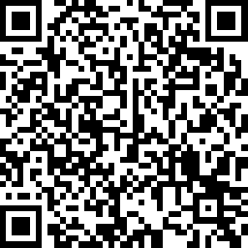
CLOSING
Thank you to our amazing host and partner company for being here today.
Please take a few moments to complete our survey.
https://www.surveymonkey.com/r/2022FCS
Notes:
Britt
REVIEW

